Slide 1

Exploratory Data Analysis
G2M insight for Cab Investment firm
16-07-2022

Slide 2

Background
XYZ is a private company in the United States. It is considering an investment in the Cab Industry due to the spectacular expansion in the previous few years and the presence of several significant competitors in the sector.
Objective : Give XYZ firm useful information so they can choose the best business to invest in.
There are four sections to the analysis:
Understanding data
predicting profit and the number of trips for each type of cab
locating the most lucrative cab firm
making investment recommendations.

Slide 3
Data Exploration
four distinct data sets. Data is available from 31/01/2016 to 31/12/2018.
Total number of observation are – 848681
Due to the lack of travel time information, we are not classifying this as an anomaly in the Price Charged feature.
List of highly correlated attributes
- KM_Travelled and Price_Charged
- KM_Travelled and Cost_of_Trip
- Price_Charged and Cost_of_Trip
Profit and ProfitPercentage

Slide 4
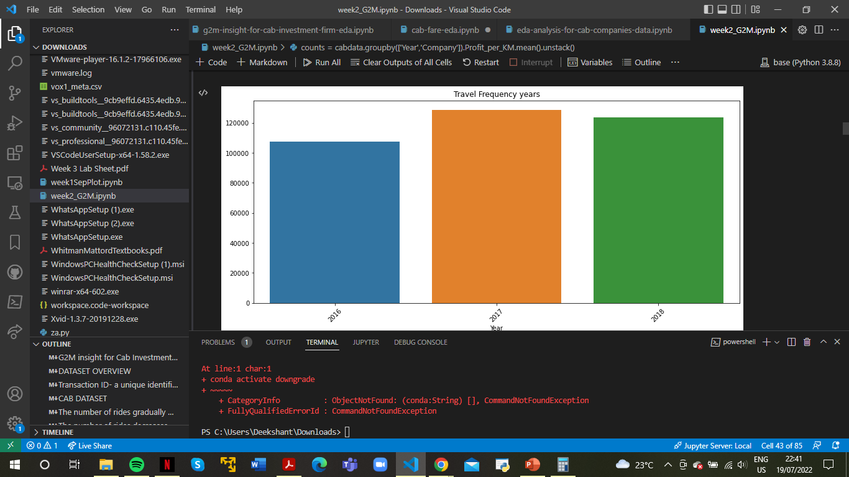
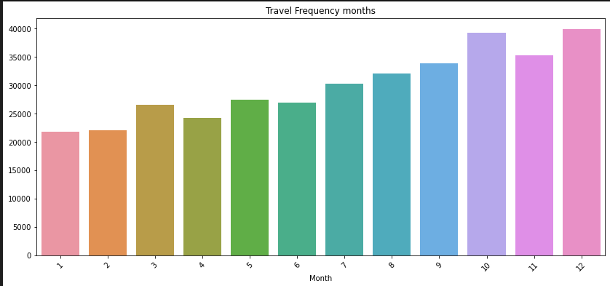
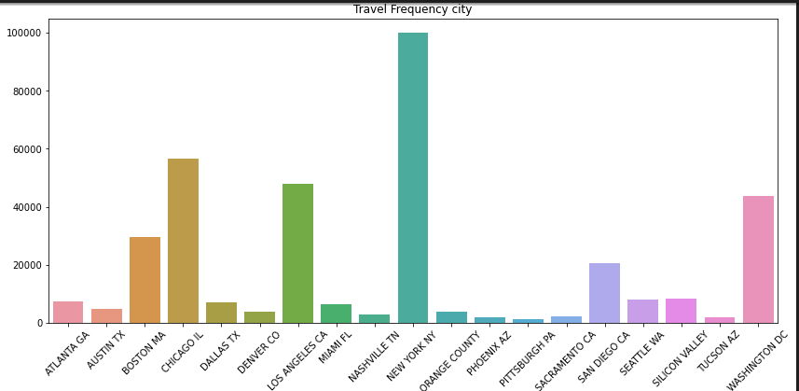
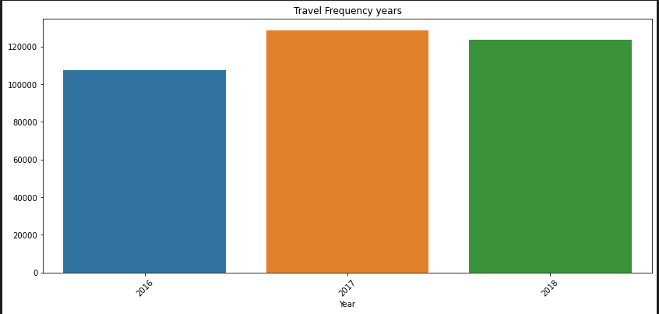
Travel Frequencies of Cab Company

Slide 5
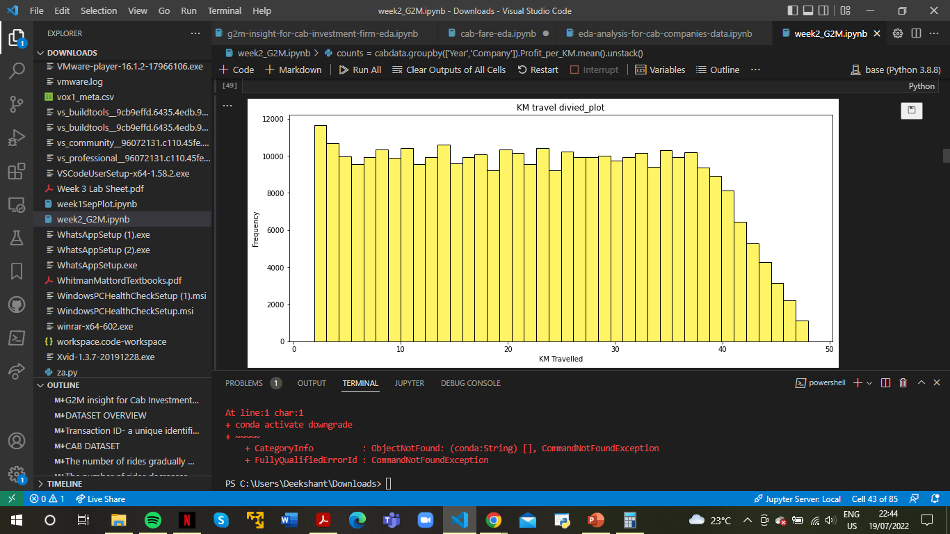
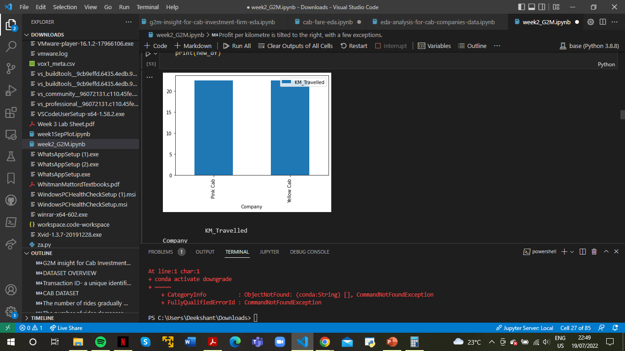
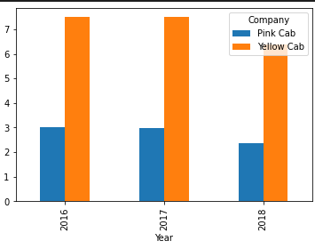
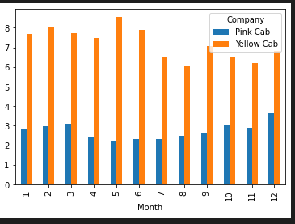
Kilometre Travelled
The number of rides gradually decreases after 40 kilometres.
Both firms have the same average number of kilometres travelled.
The average distance travelled remains constant throughout the course of three years and about 12 months.

Slide 6
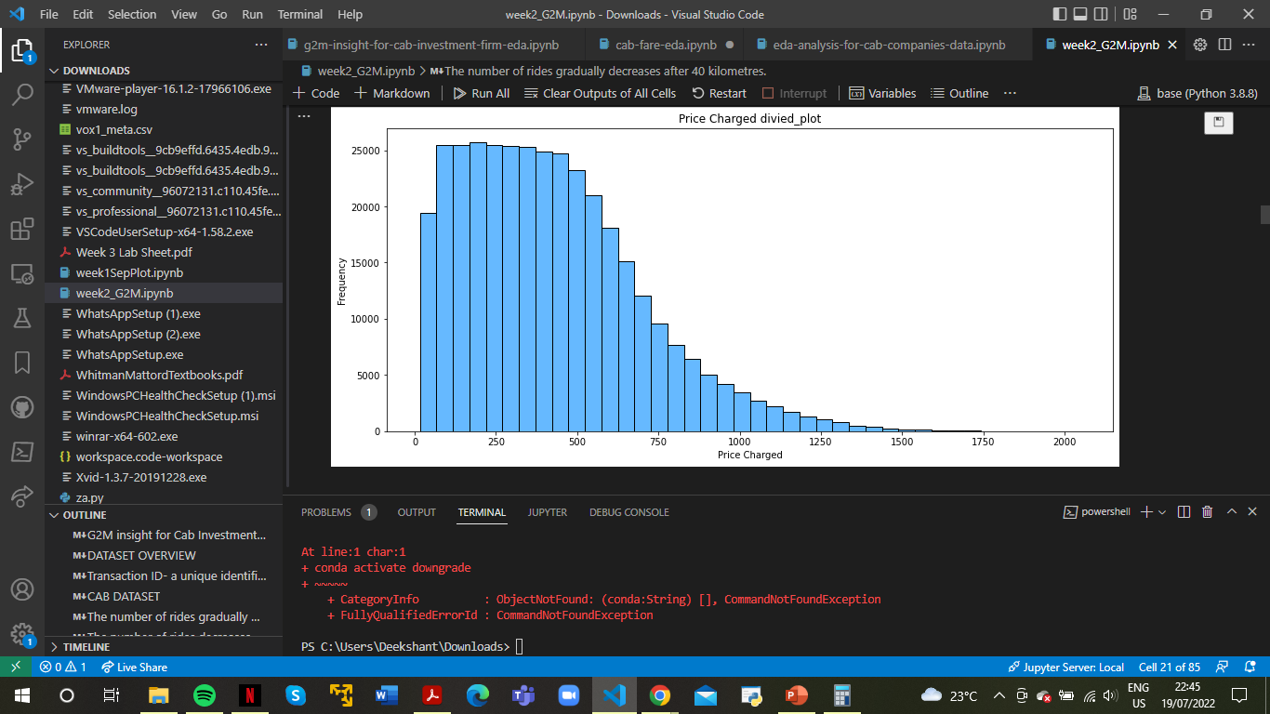
Price Charged
The number of rides decreases exponentially beyond 400.

Slide 7
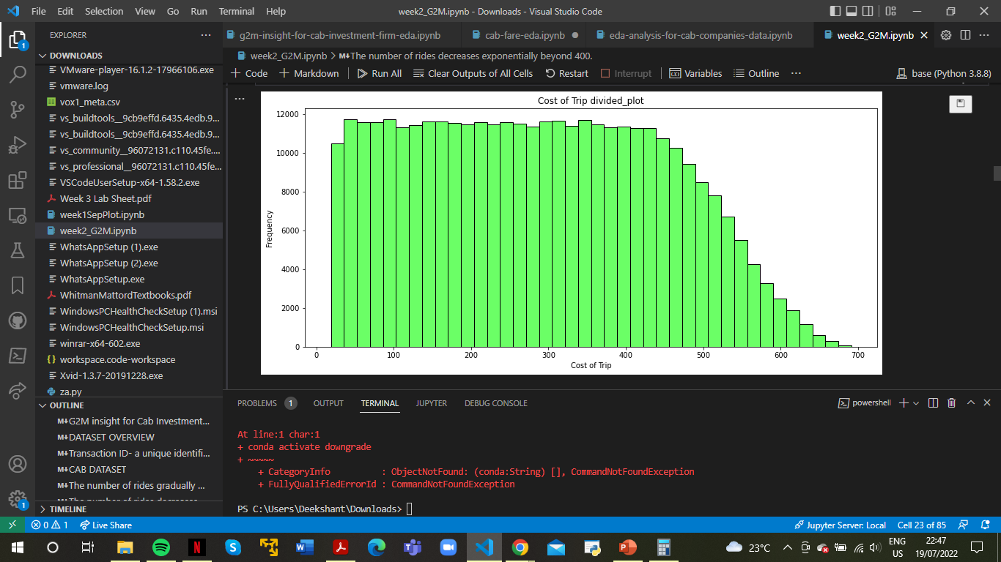
Cost of Trip Travelled
After about 420, the number of rides decreases linearly until it approaches zero around 700.

Slide 8
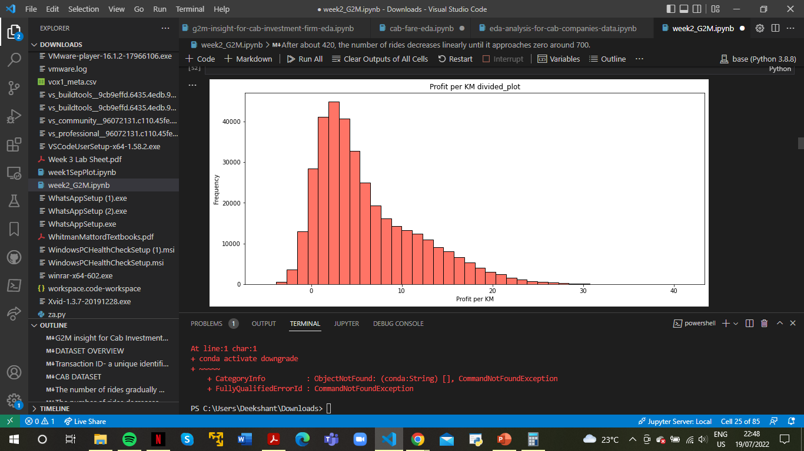
Profit Per Kilometre
Profit per kilometre is tilted to the right, with a few exceptions.

Slide 9
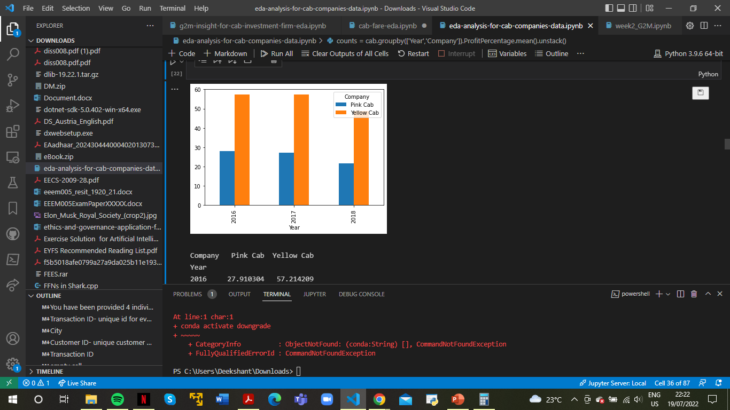




Profit analysis
Pink Cab's average profit over the last three years has been about 17-18.
Yellow Cab's average profit over the last three years has been about 28-31.
Pink Cab's profit percentage was highest in March and December, while it was lowest in June and July.
Yellow Cab's profit percentage was highest in May, February, and January, and lowest in August and July.
Unlike Profit Percentage, Pink Cab's biggest profit average is in December and its lowest from May to July > In contrast to Profit Percentage, Yellow Cab's biggest profit average is in January and February, and its lowest in August.

Slide 10
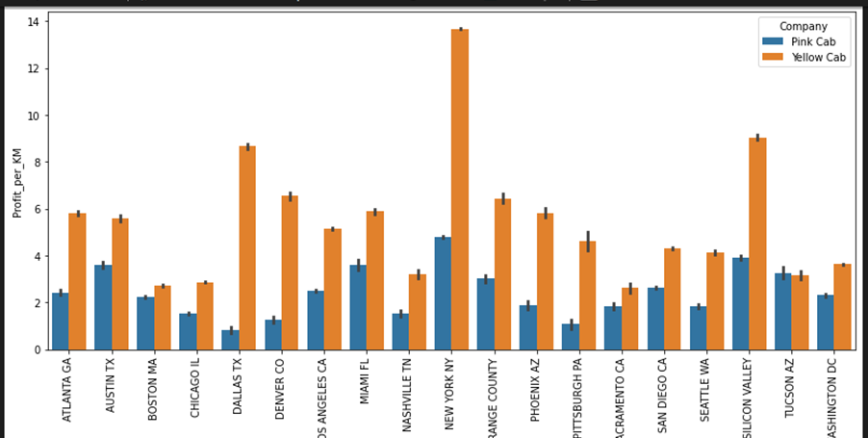
Profit Analysis Across Cities
In the accompanying Profit per KM graph, New York offers the highest earnings in terms of distance for both firms.
Dallas has the lowest profit per kilometre for Pink Cab, and Sacramento has the same for Yellow Cab.

Slide 11
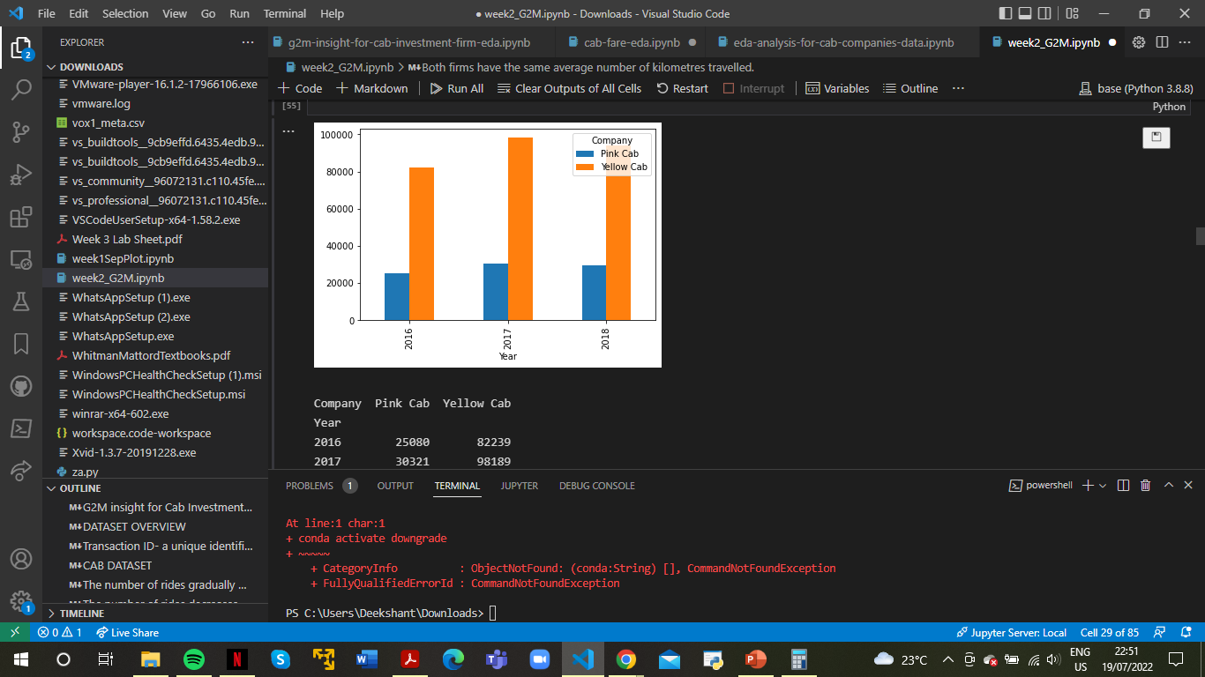
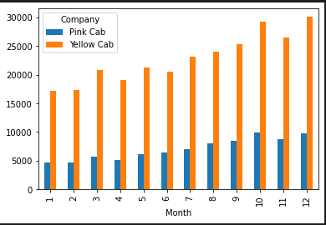
Comparison
Pink cabs provide an average of 23% of overall cab count across the three years.
Pink Cab's percentage contribution to the number of taxis remains consistent across all months.

Slide 12
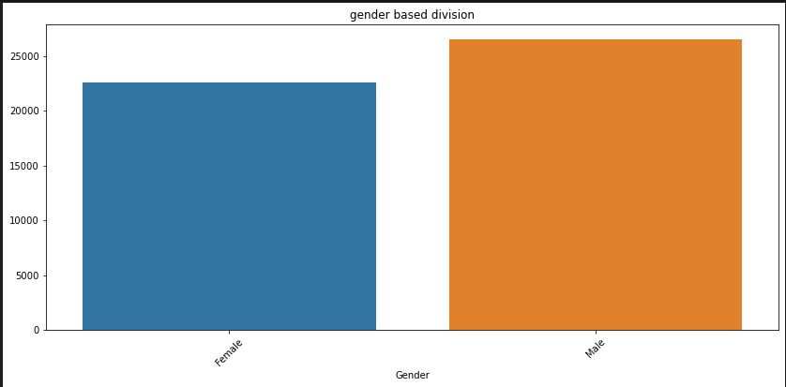
Gender Based Division
We have a higher proportion of male passengers/customers.

Slide 13
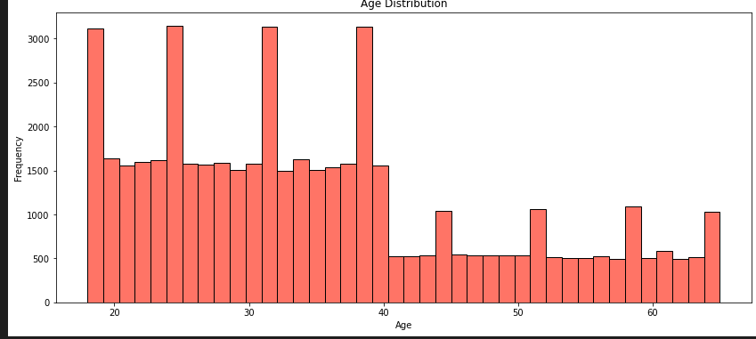
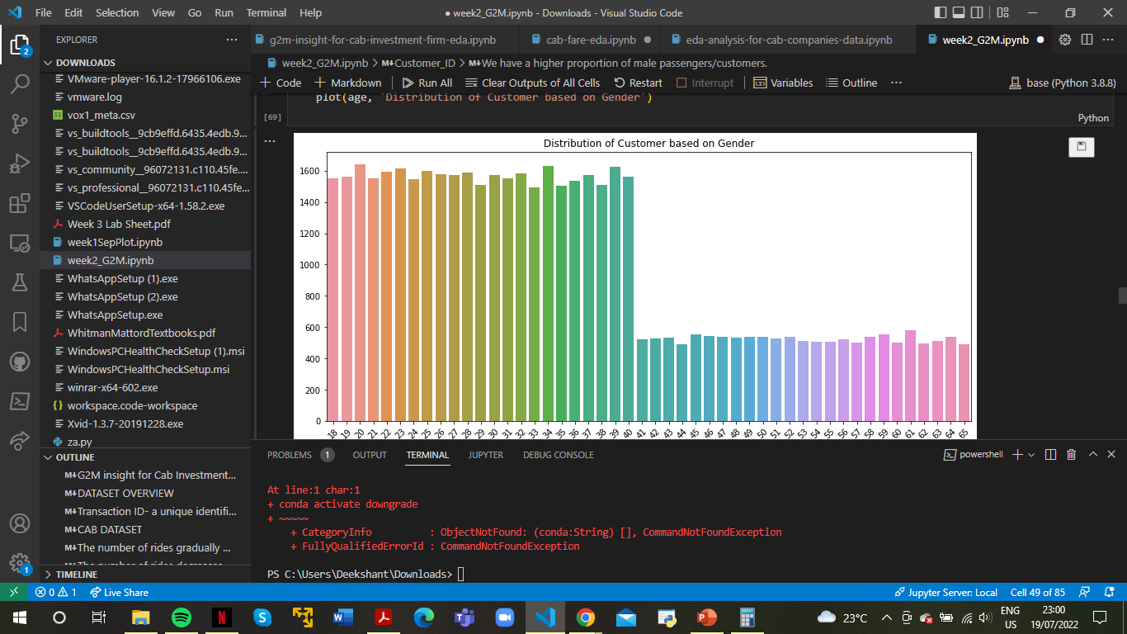
Age Based Division
The number of travellers drops precipitously beyond the age of 40. Customers under the age of 40 constitute a bigger proportion of the total.

Slide 14

Income based Analysis
The average income of our consumers of all ages is consistent.
The average income for both guys and girls is almost the same (14k to 15k).

Slide 15
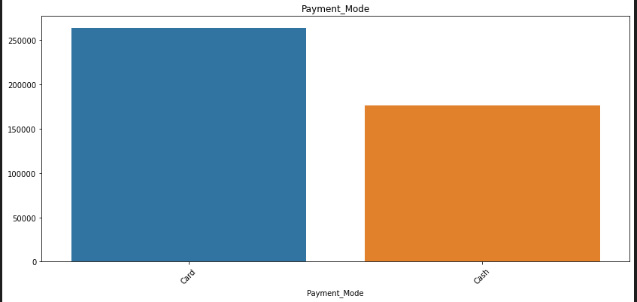
Payment Type Analysis
Customers prefer to pay using a credit card, which they use over 60% of the time.

Slide 16
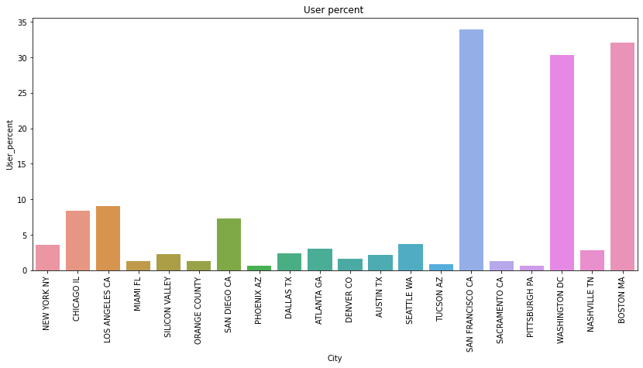
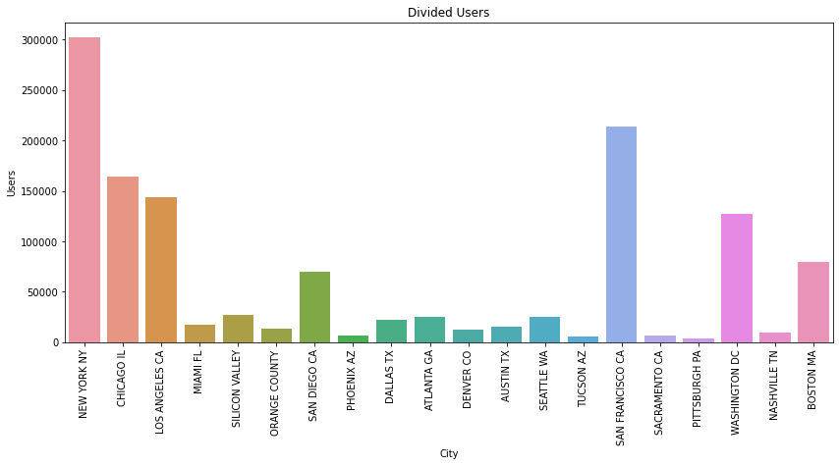
User VS User Percent
There is no relationship between users and percentage of users. The city with the most users is NEW YORK, NY, whereas the city with the most prospective users is SAN FRANCISCO, CA.

Slide 17
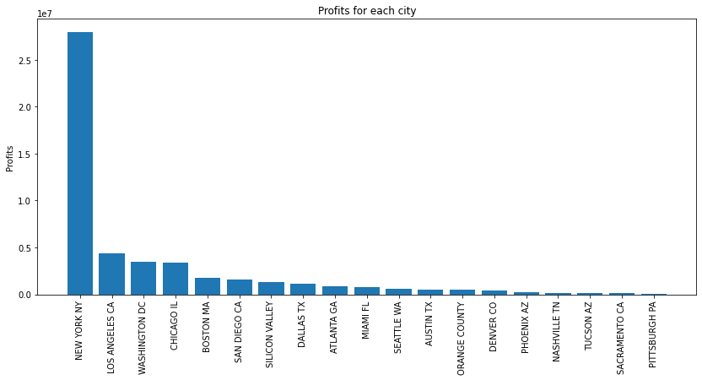
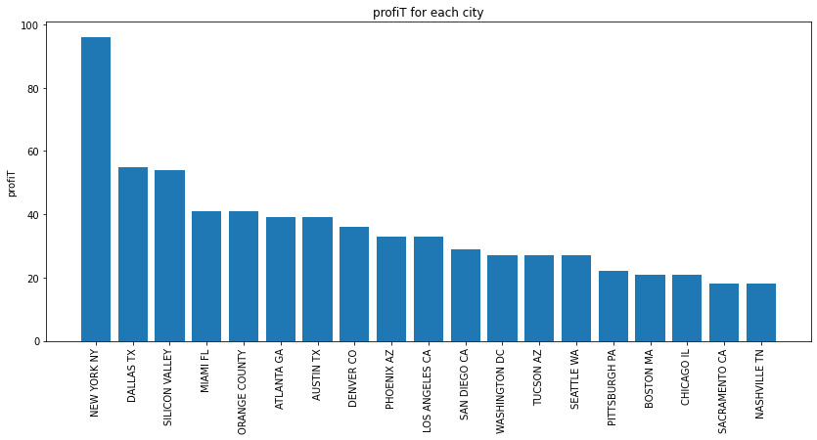
Master Data Analysis
This graphs depict the trend in city profits and profit percentages.

Slide 18
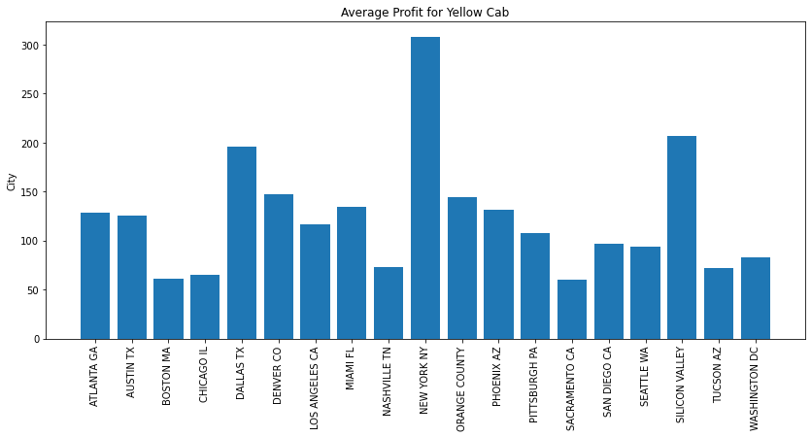
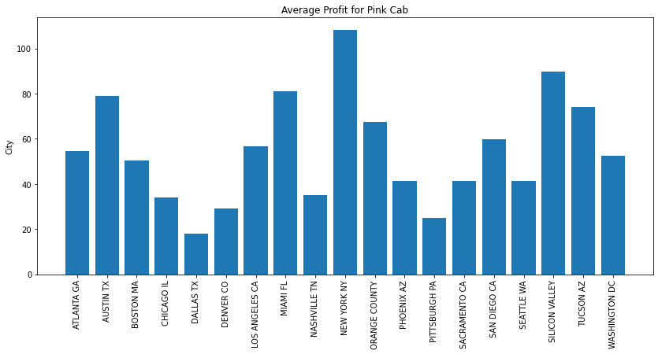
And more…
This graphs depict the trend in profits and profit percentages by city.

Slide 19
Conclusion
We compared both cab companies based on the following criteria and determined that Yellow cab was superior to Pink cab
Based on study of customers who had at least five and ten rides with the same taxi business in each sector. In each of these parts, we discovered that Yellow Cab is doing significantly better than Pink Cab.
Yellow taxis have customers of all ages, and it has been noted that they are equally popular in the 60+ and 18–25 age groups.
The average profit per kilometre for the Yellow cab is about three times more than for the Pink cab.
Both cabs are highly well-liked by those in the high- and middle-income brackets, but in this regard, Yellow cab outperforms Pink cab in providing services to all three income class groups.
…We will advise investing in Yellow Cab based on the aforementioned reason.

Slide 20
Thank You

